Slide 1
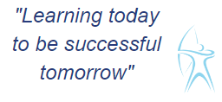


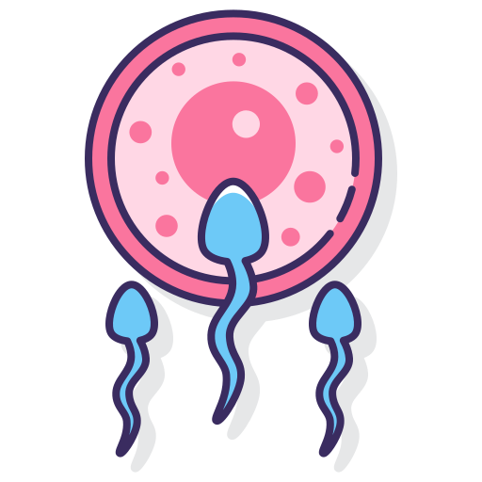



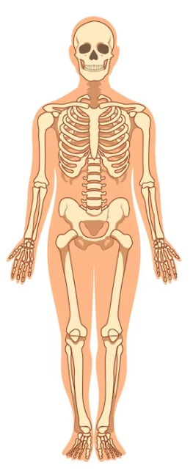
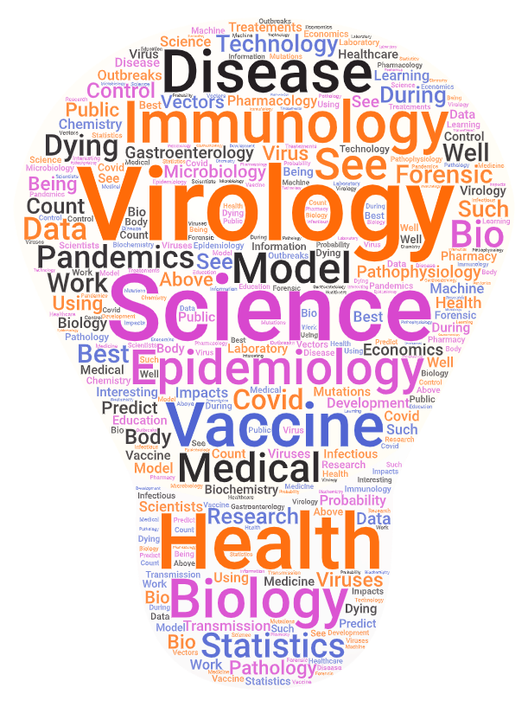
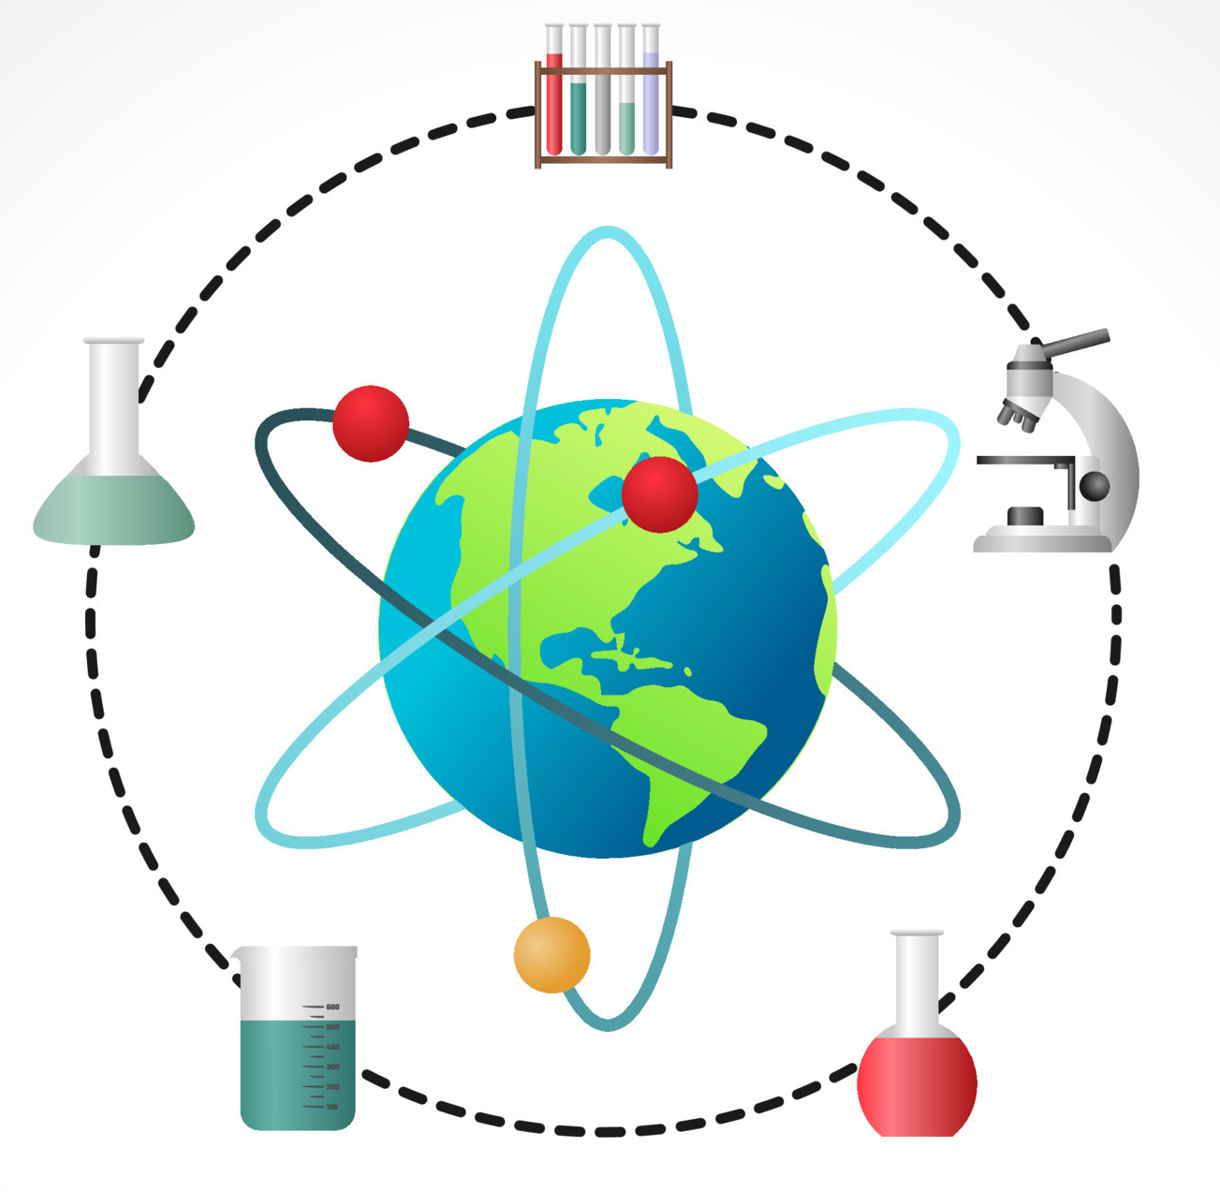




Mixtures and Separation
Mixtures
Solutions
Evaporation
Chromatography
Distillation
Energy and Resources
Energy from food
Energy transfers and stores
Fuels
Other energy resources
Using resources
Reproduction
Animal sexual reproduction
Reproductive organs
Becoming pregnant
Gestation and birth
Growing up
Curriculum Intent: In Science we plan a curriculum which is broad, balanced and well informed, designed to match the full range of pupils’ needs and to ensure highly effective continuity and progression in their learning. The curriculum equips pupils in all year groups with an excellent balance of subject knowledge and understanding, and the skills of scientific enquiry. To enable them have an awareness of the scientific society in which they live.
The context in which science is taught is relevant to pupils’ lives, capture their interest and reflects current science from the worlds of industry, research and other science-based endeavours such as health care but is also flexible to allow current science topics that make the news to be understood.
In key stage 3, sufficient time and high quality practical resources are used to teach science through practical investigation and illustrations are provided, that promote pupils understanding and progression.
Cells
Life process
Organs
Tissues
Cells
Organ System
Acids and Alkalis
Hazards
Indicators
Acidity and alkalinity
Neutralisation
Neutralisation in daily life
Chemistry
Physics
Biology
HAT 1+2
Muscles and Bones
Muscles and breathing
Muscles and blood
The skeleton
Muscles and moving
Drugs
Electrical Circuits
Current
Models for circuits
Series and parallel
Voltage and resistance
Using electricity
HAT 3+4
Careers in Science
Scientist
Chemistry
Chemist
Microbiologist
Meteorologist
Zoology
Forensic science
Astronomer
Geologist
Forces
Forces
Springs
Friction
Pressure
Balanced and unbalanced
World Science day:
Fri, 10 Nov 2023
The Particle Model
Solids, liquids and gases
Particles
Brownian motion
Diffusion
Air pressure
HAT 5+6
Atoms Elements and Compounds
The air we breathe
Earth’s element
Metals and non-metals
Making compounds
Chemical reactions
Ecosystems
Adaptations
Effects of the environment
Effects on the environment
Transfers in food chains and food webs
Sound
Sounds as vibrations
Longitudinal waves
Volume (amplitude), Pitch (frequency
How sound travels and interacts with the surroundings.
Year 7 –Science

Slide 2
Food and Digestion
Nutrients
Uses of nutrients
Balanced diets
Digestion
Absorption
Fuels
Burning fuels
Oxidation
Fire safety
Air pollution
Global warming
Fluids
The particle model
Changing state
Pressure in fluids
Floating and sinking
Drag
Curriculum Intent: In Science we plan a curriculum which is broad, balanced and well informed, designed to match the full range of pupils’ needs and to ensure highly effective continuity and progression in their learning. The curriculum equips pupils in all year groups with an excellent balance of subject knowledge and understanding, and the skills of scientific enquiry. To enable them have an awareness of the scientific society in which they live.
The context in which science is taught is relevant to pupils’ lives, capture their interest and reflects current science from the worlds of industry, research and other science-based endeavours such as health care but is also flexible to allow current science topics that make the news to be understood.
In key stage 3, sufficient time and high quality practical resources are used to teach science through practical investigation and illustrations are provided, that promote pupils understanding and progression.
Plants and Reproduction
Pollination
Fertilisation and dispersal
Germination and growth
Rocks
Rocks and their uses
Igneous and metamorphic
Weathering and erosion
Sedimentary rocks
Materials in the Earth
Chemistry
Physics
Biology
HAT 1+2
Energy
Temperature changes
Transferring energy
Controlling transfers
Power and efficiency
Paying for energy
Unicellular Organisms
Unicellular or multicellular
Microscopic fungi
Bacteria
Protoctista
Decomposers and carbon
HAT 3+4
Careers in Science
Scientist
Chemistry
Chemist
Microbiologist
Meteorologist
Zoology
Forensic science
Astronomer
Geologist
Light
Light on the move
Reflection
Refraction
Cameras and eyes
Colour
World Science day:
Fri, 10 Nov 2023
Metals and their uses
Metal properties
Corrosion
Metals and water
Metal and acids
Pure metals and alloys
Heating and Cooling
How changes temperature affect motion and spacing of particles
internal energy stored in materials.
How heating and cooling causes changes of state.
How temperature affects shape and density,
Heating and Cooling Curves.
HAT 5+6
Compounds and Mixtures & Periodic Table
Dalton’s atomic model
Chemical properties
Mendeleev’s table
Physical trends
Chemical trends
Sound and Hearing
Sound waves
Frequencies of sound waves
Sound waves’ shape and characteristics.
How Sound travels
How sound is made
How sound is detected by microphones and the ear-drum
Auditory range of humans and animals
Breathing and Respiration
Aerobic respiration
Gas exchange system
Getting oxygen
Comparing gas exchange
Anaerobic respiration
Year 8 Science

Slide 3
Inheritance and Selection
Variation, DNA, Genes and Chromosomes
Inheritance
Natural and artificial selection
Evolution
Reactivity
Types of explosion
Reactivity
Energy and Reactions
Displacement
Extracting materials (metals)
Forces and Motion
Forces and movements
Energy for movement
Speed
Turning forces
More machines
Curriculum Intent: In Science we plan a curriculum which is broad, balanced and well informed, designed to match the full range of pupils’ needs and to ensure highly effective continuity and progression in their learning. The curriculum equips pupils in all year groups with an excellent balance of subject knowledge and understanding, and the skills of scientific enquiry. To enable them have an awareness of the scientific society in which they live.
The context in which science is taught is relevant to pupils’ lives, capture their interest and reflects current science from the worlds of industry, research and other science-based endeavours such as health care but is also flexible to allow current science topics that make the news to be understood.
In key stage 3, sufficient time and high quality practical resources are used to teach science through practical investigation and illustrations are provided, that promote pupils understanding and progression.
Plant Growth
Plant Growth
Plant adaptations
Plant Products
Growing Crops
Farming Problems
Making Materials
Ceramics
Polymers
Composites
Problems with Materials
Recycling Materials
Chemistry
Physics
Biology
HAT 1+2
Force Fields and Electromagnets
Force fields
Static and current electricity
Resistance
Electromagnets
Physics Revision and Projects
Working Scientifically
Models in Science
Energy
Forces
Waves and Fields
Machines
Biology Revision and Projects
Working Scientifically
Cells, systems and movement
Other organ systems
Reproduction and health
Energy in Ecosystems
Genetics and Evolution
HAT 3+4
Careers in Science
Scientist
Chemistry
Chemist
Microbiologist
Meteorologist
Zoology
Forensic science
Astronomer
Geologist
Environmental Chemistry
Rocks and Buildings
Acid Rain
Measuring Air Pollution
Global Warming
Ozone Layer
World Science day:
Fri, 10 Nov 2023
Chemistry Transistion to GCSE
Ions
Energy Transfers
Rates of Reaction
Chemical Equations
Equilibria
HAT 5+6
Working Scientifically
Analyse
Communicate
Enquire
Solve
Physics Transistion to GCSE
Differences
Fields
Cause and Effect
Links Between Variables
Models
Biology Transition to GCSE
Diseases
Control Systems
Testing Medicines
Ecology
In and Out (cell transport)
Year 9 Science

